Slide 1
Presenter: Christina Rajsic Director of Health Promotion Brant County Health Unit Co-Chair Grand River Healthy Communities November 22 , 2017
Growing Vital and Healthy Communities

Slide 3
The Bottom Line in Health for our Communities
Women with the lowest incomes in Brantford tend to die 19 years earlier than their wealthiest neighbours.
Men with the lowest incomes tend to die 16 years earlier than their wealthiest neighbours.
Notes:
COOMUNIY VITALITY
Social Connectedness
Things in common with others
Welcomed in the community
Supportive social networks
Friends
Family
Neighbours
Safe Places to live
Walkable without fear
Social Safety Nets –
accessible Services

Slide 4
Identifying Priority Impacts on Health and Wellbeing
Health Equity forum hosted in March 2015 with over 100 in attendance
Health impact themes were identified from several local reports and
They were presented to attendees in the context of the Canadian Index of Wellbeing
Randomly assigned to one of ten workgroups , attendees chose their top priorities and present their rational to the whole

Slide 5
Symbols in the Healthy Brantford Vision Tree
Notes:
REALIZING THE VISION: Symbols in the Healthy Brantford Vision Tree
The Vision Tree is based on our native apple tree. It represents our community's view of what is needed
to become a Healthier Brantford:
The ROOTS are the key ways to involve members of our community:
The TRUNK represents the rights of all people to have access to good health and well-being
The LIMBS are priorities – the most important impacts on health that need improvement
The FRUIT, composed of red arrows, identify main concerns linked to each of the priority issues
The arrows, representing SEEDS, give ideas for strategies to improve our health outcomes

Slide 6
About the Priorities
Optimal physical, mental, and spiritual health do not occur in isolation but are a result of all aspects of an individual’s life: Education, food security, prosperity, active living, and access to supportive health systems
Education
Greater knowledge = greater ability to make healthy choices
More education = Higher health literacy =
better food choices
Able
to afford healthy food
Higher education =
Better employment
Better benefits
Provision of sick time
Prosperity
Food
security
Higher income =
Better access to
health resources
& less
financial
stress
Access to healthy food = better diet
Able to navigate resources & services
Better Health
Less stress
Access to nutritious food = prevention and treatment of illness
Higher income =
able to afford recreation &
more time for leisure
Healthy
weights
Better
mental
health
More active individuals = healthier individuals = reduced burden on healthcare
system
Health Systems
Active Living
Better health supports
= better preventive and treatment care
An active life = lower rate of chronic disease

Slide 7
Community Engagement
Inclusion of all Diversity
All members recognize the strengths and diversity in our community by showing sensitivity, respect and fairness in welcoming all people.
Community Ownership
Members work together in engaging, encouraging and inspiring all to promote the necessary actions to carry out our combined mission.
Shared Leadership
Members of our community and our agencies join forces to arrive at decisions that provide direction to fulfil a common vision.
Multi-Sector Cooperation
Members from our community and all our local sectors work together to ensure activities complement each other, are resource wise, and meet mutual goals.

Slide 8
Multi-Sector Approaches
To name a few:
Ministry of Health and Long Term Care
Local Health Integrated Network
Brant County Health Unit
Grand River Community Health Centre
Brant Healthcare System and other allied clinical care supports
Ministry of Child and Youth Services
Best Start Network
Child and Youth Services Network
Indigenous Communities
Reserve and Urban health and social supports
Municipalities’ Strategic Plans
i.e. Healthy Brantford
Transportation task groups in local jurisdictions

Slide 9
Collective Impact
“Collective Impact is the commitment of a group of important actors from different sectors to a common agenda for solving a specific social problem, using a structured form of collaboration”
- Kania, J. and Kramer, M.

Slide 10
CI: “Connecting People” (OTF)
CI Model for Collaboration:
Groundwork
Build the case
Concept Design
Proposal development
Implementation
Evaluation and Learning

Slide 11
Where We Are Now: Implementation
Education Action Forum | Building our Skills | January 18, 2018
 | Access to Education
 | High School Graduation
 | Teaching Life Skills in Schools
Food Action Forum | Affordable Food Healthy Food Local Food Systems | May 2, 2017
Prosperity Action Forum | Secure Incomes | September 21, 2017
 | Housing Help
 | Safe Place to Live
Health Systems Action Forum | Coordinated Services | November 22, 2017
 | Affordable Transportation
 | Services Meet Needs
Active Living Action Forum | Recreation and Leisure | June 22, 2017
 | After school Programs
 | Arts and Culture
Notes:
With a Celebration Breakfast on April 25th at the Sanderson Centre, We will report back to the community on our progress to date
And kick-off the implementation phase with a CALL TO ACTION.
We will be inviting community stakeholders to:
self-select the priorities that fit best with their knowledge, expertise and interests and
attend our Action Forums
Use the forum to examine current efforts to address the priority and related issues
Come to an understanding of how to collaborate to align resources and interventions to support each others’ work
Commit to develop the necessary partnerships to augment the current actions and structure new strategies
We really expect Action Teams and initial Actions Plans to emerge from these Forums that based on current community structures and actions.
In other words – we do want to build on what is already there and augment capacity.
In turn, HB will be provide the HB Structure to support their work and their success in improving community health

Slide 13
SYSTEM For HEALTH and WELLBEING Potential targets and indicators
SYSTEMS ISSUE | Targets | Examples of Indicators
Coordinated Services | Agencies work together to provide effective services | 47% of individuals aged 12 and older are vaccinated against influenza (Ontario = 53%) (Data source: CCHS, 2013-14) 15% of individuals 12+ consider their health to be ‘poor’ or ‘fair’ (Ontario = 12%) 34% of individuals 12+ report having one or more chronic health conditions (Data source: CCHS, 2013-14) Life Expectancy at birth in years: 80.2 years for females & 74.8 years for males (Data source: IntelliHealth, 2003-09) 10% of Brant students (grade 7-12) reported smoking cigarettes daily or occasionally in the past year (Data source: OSDUHS, 2015).

Slide 14
More potential targets and indicators
SYSTEMS ISSUE | Targets | Examples of Indicators
Services Meet Needs | People get the services needed and wait lists are reduced | 32% of students in grades 7-12 report moderate-to-high psychological distress (Ontario = 34%) (Data source: OSDUHS, 2015) 11% of individuals aged 12 and older report having a mood disorder (e.g., depression) (Ontario = 8.6%) (Data source: CCHS, 2013-14) 204 crisis situations were dealt with by the Brant Community Response Team during 2016. 19% were attribute to mental health (Data source: Brant Community Response Team: Annual Report, 2016) 55% of individuals who received non-government funded home care received that care from family members (CCHS, 2013-14) 94% of individuals aged 12 and older have a regular medical doctor (Ontario = 92%) (Data source: CCHS, 2013-14) 17% of individuals felt that during the past 12 months, there was a time when they needed health care but didn’t receive it (Ontario = 11%) (Data source: CCHS, 2013-14) The top reason for not getting care was “wait time too long”.

Slide 15
More potential targets and indicators
SYSTEMS ISSUE | Targets | Examples of Indicators
Affordable Transportation | Transportation get people to where they need to go | 11% of individuals aged 12 and older walk to work or school (Ontario = 17%) (Data source: CCHS, 2013-14) 0.72% of the population is hospitalized each year due to a motor vehicle collision (Ontario = 0.45%) (IntelliHEALTH ONTARIO, 2015)

Slide 16
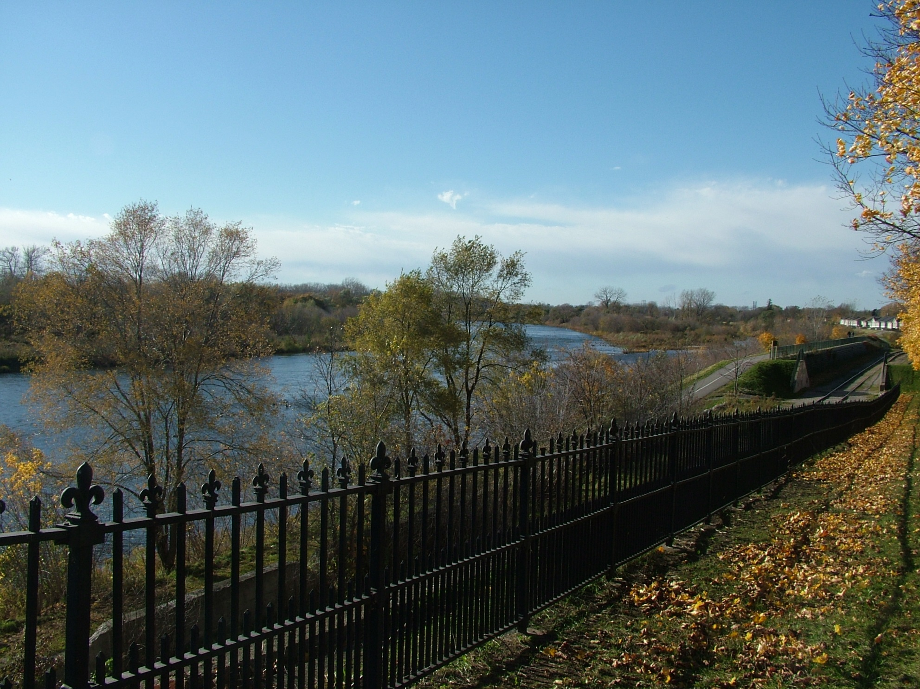

Slide 17
Thank you!

